Slide 1

Metal or Not?
Team 3: Eileen Blum and Roberto Hernández Palomares
Building a model to classify if song lyrics are of the metal genre or not?
https://github.com/eileenblum/Music-Project
May 2020 Data Science Bootcamp

Slide 2
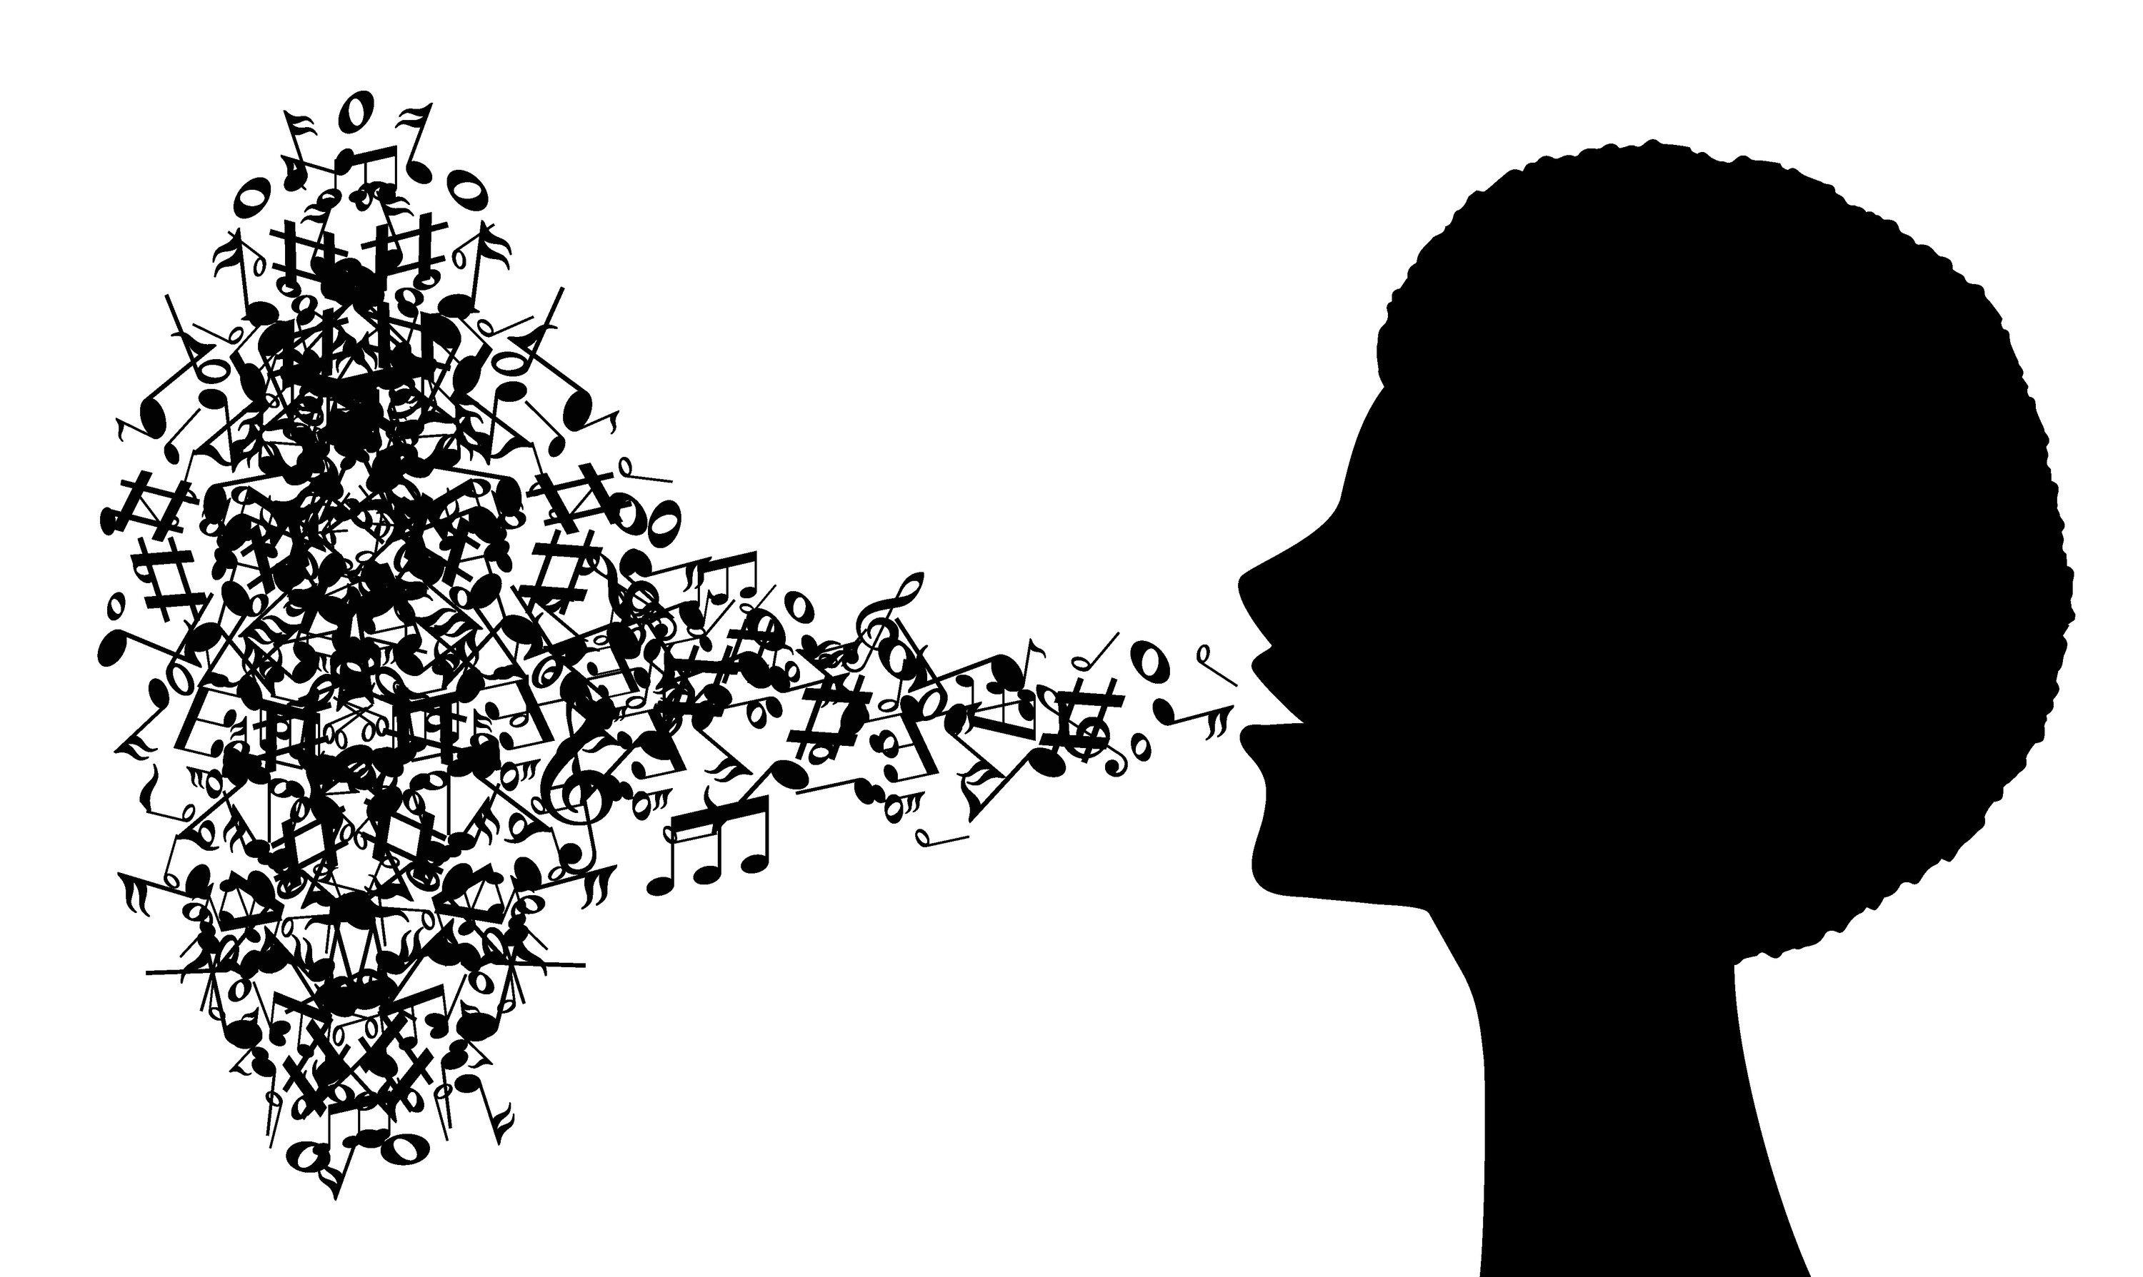
The Question and Goal
Fact: You may have noticed that lyrics of songs from different genres of music tend to focus on different topics.
Question: When you think of reggae music what common words come to mind? What about when you think of heavy metal?
Goal: Create a classifier to distinguish song lyrics by genre.

Slide 3
Methods
We downloaded 2 lyrics datasets from kaggle.com:
Large Metal Lyrics Archive (228000 songs scraped from http://www.darklyrics.com)
AZLyrics song lyrics (147000 songs scraped from http://www.azlyrics.com)
We used GenSim and NLTK for preprocessing.
Neural Net: We used the Word2Vec neural network to embed individual words into 150-dimensional points in space then K-cluster them after PCA according to their semantic similarity.
Supervised Learning: We trained a genre classification model using the DecisionTreeClassifier from sklearn and Word2Vec vectors.

Slide 4
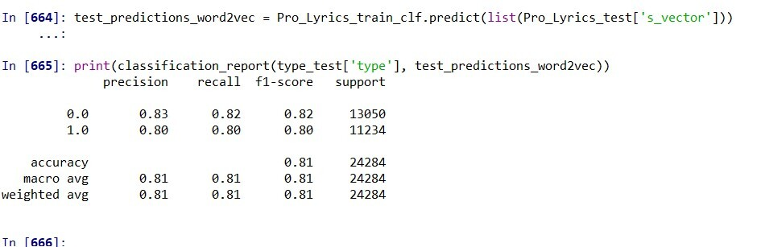
Results and Challenges
The data required a lot of cleaning and trimming of files.
We had to reduce the specificity of our claims because we did not have the time to find one specific genre for comparison to the metal lyrics.
A large amount of data was necessary for training the Word2Vec in order to improve the accuracy of semantic clustering.
We achieved 81% lyric classification accuracy by using a Decision Tree Classifier:

Slide 5
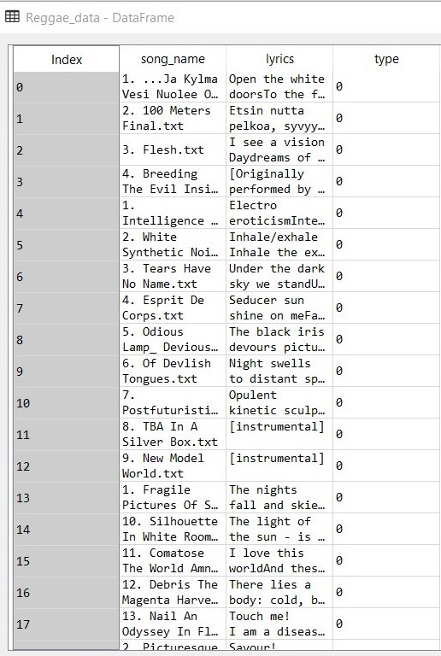
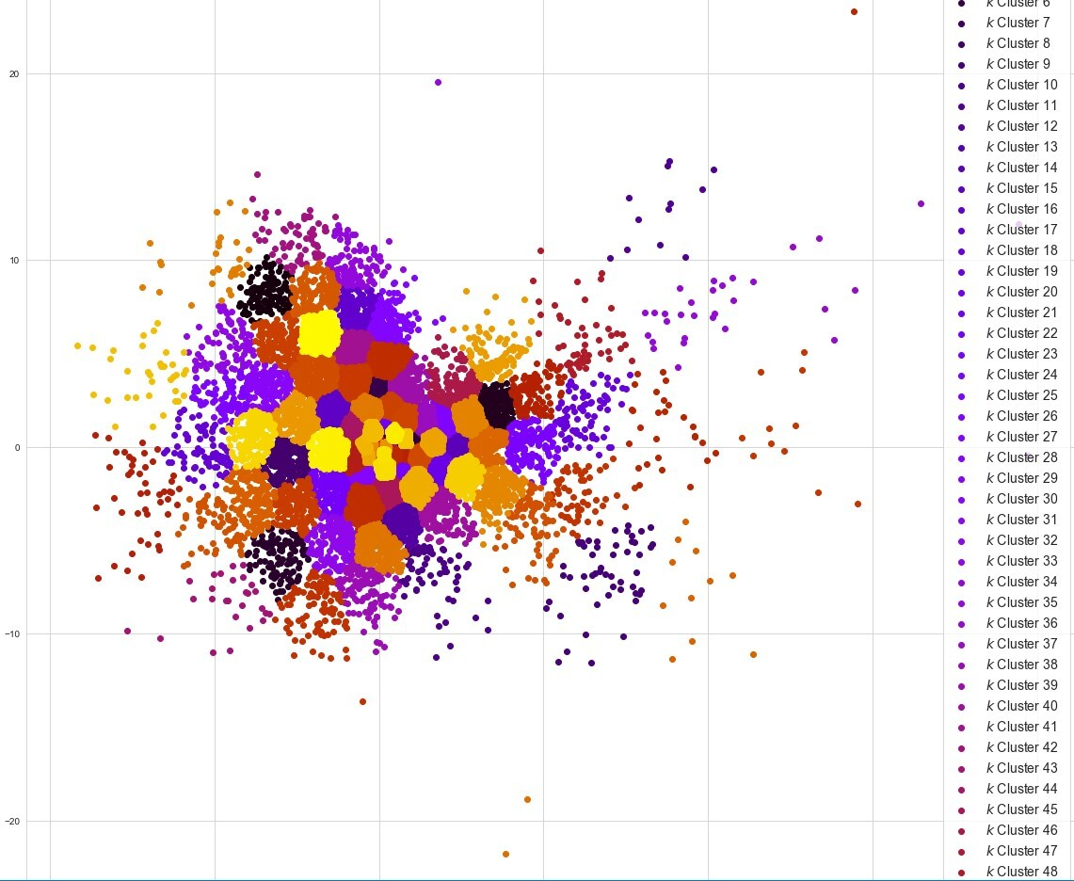
Data Frame Input to Word2Vec
K-Means Clustering of words with PCA
k = 100 clusters

Slide 6
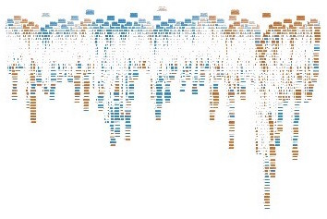
Decision Tree

Slide 7
Future Work
This project could be extended to compare lyrics from specific genres, which could be useful for categorizing music without having to analyze acoustic features.
Another potential extension of this project could be to determine the specific vocabulary of a musical genre and use that to help produce new song lyrics.

Slide 8
Thank You!
Team 3: Matelinguistica
https://github.com/eileenblum/Music-Project
Eileen Blum Roberto Hernández Palomares
eileen.blum@rutgers.edu hernandezpalomares.1@osu.edu
Rutgers University The Ohio State University

